Slide 1


Slide 2

Return

Slide 3

Return

Slide 4

Return

Slide 5

Return

Slide 6
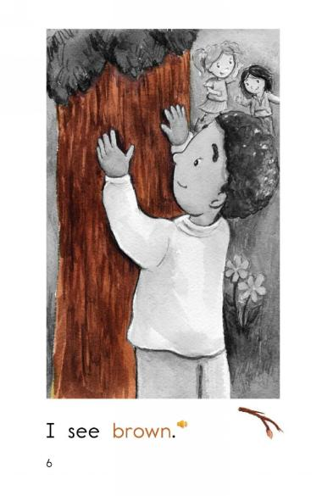
Return

Slide 7

Return

Slide 8

Return

Slide 9

Return

Slide 10

Return

Slide 11
blue
green
brown
purple
pink
red
orange
gold
Click on the colored buttons to start getting to know the colors!

